Slide 1

ONLINE BLOOD BANK MANAGEMENT SYSTEM
MINI PROJECT - 1
Under the supervision of:
Dr. P. Chandrashekar Reddy
BATCH NO 66
NAME ROLL NO.
V.BHUVANA SRI [19H51AO5J2]
J.NIKHIL [19H51A05K6]
N.BHOOMIKA [19H51A1220]
P.SHRAVANI [19H51A1221]

Slide 2
Introduction
Due to the pandemic, the demand for blood donation has increased, and so have the donors. Many of the blood banks in rural areas or underdeveloped areas still use the manual file system for storing the details of donors. We, as a team came up with an online blood bank management system that can be used by various hospitals simultaneously to store the information regarding the available blood bags.

Slide 3
Need statement and explanation
Manual system of maintaining records must be replaced by a web based management system that can efficiently store donor details and can be accessed by various hospitals.
Explanation:
Admins in hospitals who maintain records and entries of donors etc, don’t have knowledge about database or DDL. An online platform can be introduced which can covers all the functions of a database and is easy to use even for the naïve.

Slide 4
Abstract formulation
We have designed a low-cost, compact paper-bag making machine to produce paper-bags and minimize the usage of plastic bags for an eco-friendly society. The system being semi-automatic is capable of producing single-size paper-bags from A3 size papers (Our model is restricted to A3 size papers alone).
The project can be implemented by making use of Arduino Uno micro-controller, IR sensor, actuators, DC motors and servo-motor.
The proposed model can be operated in small-scale industries or homes for producing paper-bags and we believe it can reduce the usage of polythene bags.

Slide 5
EXISTING SOLUTIONS FOR THE PROBLEM:
FULLY AUTO MATED PAPER BAG MACHINE:
Automation Grade | Automatic, Semi-Automatic
Capacity(Pieces per hour) | 10000 pieces per hour
Max Bag Length | 180mm-690mm
Max Bag Width | 100mm - 430mm
Size | 12ft X 9ft
Voltage | 3 H.P motor
motor | AC Induction motor

Slide 6
Features of Fully Auto Mated Paper Bag Machine :-
The paper is pulled with the help of pulling mechanism, is passed to the folding mechanism by using roller, belt and conveyor.
Gluing mechanism is used in the system to apply glue on the paper.
After this, cutting and punching operations are carried out and final product is taken out as paper bag.
CONS:
It is very expensive.
It has very high voltage.
It is bulky.
PROS:
Precise gathering and folding.
Independent operations.
Durability and longer life-span.

Slide 7
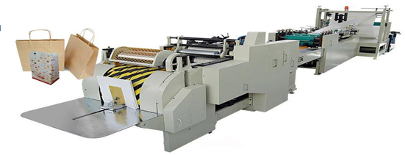
2.SQUARE BOTTOM WITH PUNCHING PAPER BAG MACHINE:
Width of Paper | 600-1300 mm
Cutting Length | 270-500 mm
Width of Paper Bag | 230-450 mm
Length of Paper Bag | 225-450 mm
Width of Bag Bottom | 80-180 mm
Paper Weight | 80-160 mm
Max. Diameter of Paper Roll | 1500 mm
Internal Diameter of Roll Core | 76 mm
Max. Speed | 150 Pcs/min
Power | 15 KW
Weight | 9000 KG
Overall Dimension | 9600 mm X 2500 mm X 1800 m

Slide 8
Features of Square Bottom Paper Bag Making Machine :-
• It is fitted with servo motor drive to drive the machine faster and smoothly.
• This device has an Accurate and automatic lubricating oil supply
Material feeding using hydraulic lift structure. Unwinding automatic tension control.
Side glue using the auto gluing system.
Automatic shutdown. When it run out material.
It has a synchronous adjustment mechanical design, which can significantly reduce the adjustment time to replace the size.

Slide 9
3.Portable Paper-Bag Making Machine
cost | (Rs)3000
Max speed | 1 pc/min
Voltage of motor | 5 V
Motor | DC Motor
Paper size | Any size can be produced by adjusting the size of the rollers

Slide 10
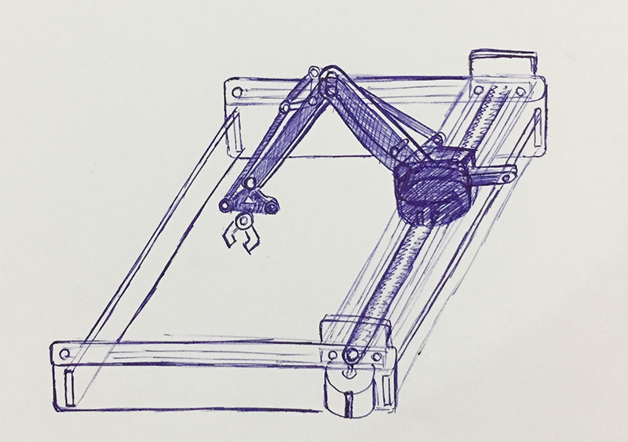
Features of portable paper bag machine:-
They have used Indian clone of OWI Robotic Arm, the total system cost is INR 3000.
Currently their system can produce 1 paper-bag per minute.
This is because of the 5V DC geared motor used in entire system. Also glue needs to be replaced frequently.
Further one human assistance is required.
the machine can be deployed in small-scale industries, homes, etc.

Slide 11
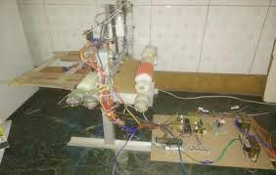
4.Optimized Embedded System for Automated Paper Bag Production
This has used micro-controller based design approach which has kept the cost of the system significantly low as compared to PLC based designs.
They have used recycled approximately A4 size which is feed into machine with the help of two rollers.
They have used two IR sensors one is used for applying adhesive and the second sensor is triggered which signifies that middle portion of the page is at the center of the other roller and a blade is applied to fold a paper into two halves and passed through a roller.
The glue placed on one half portion of the page gets stick to other half of the page which gives a nice half A4 size paper bag.

Slide 12
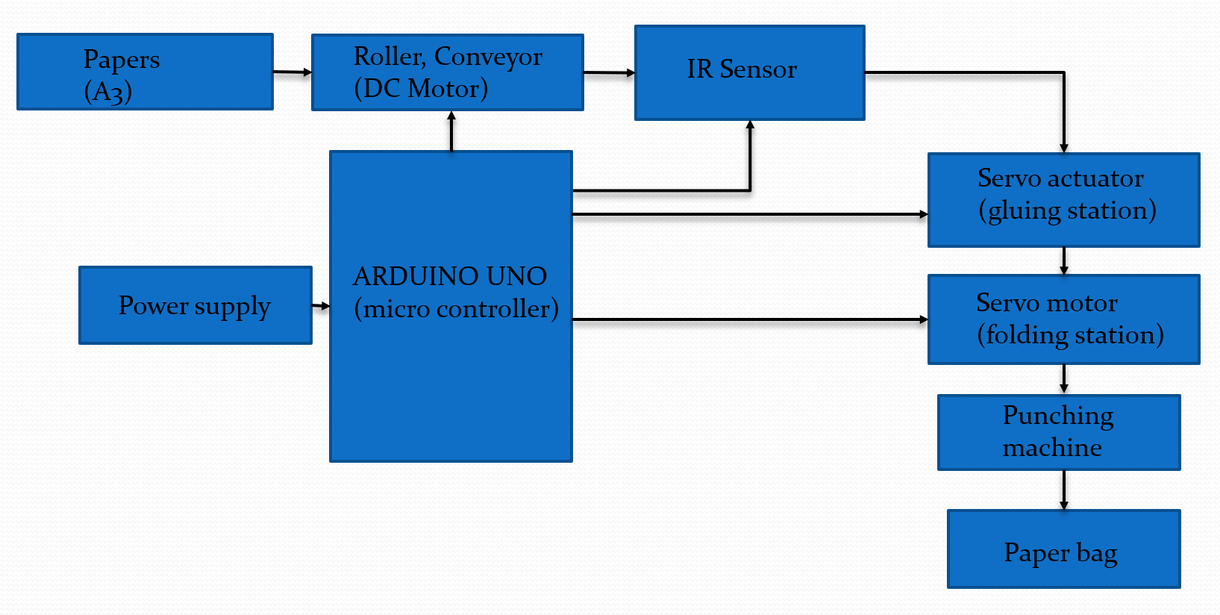
Block Diagram of the model

Slide 13
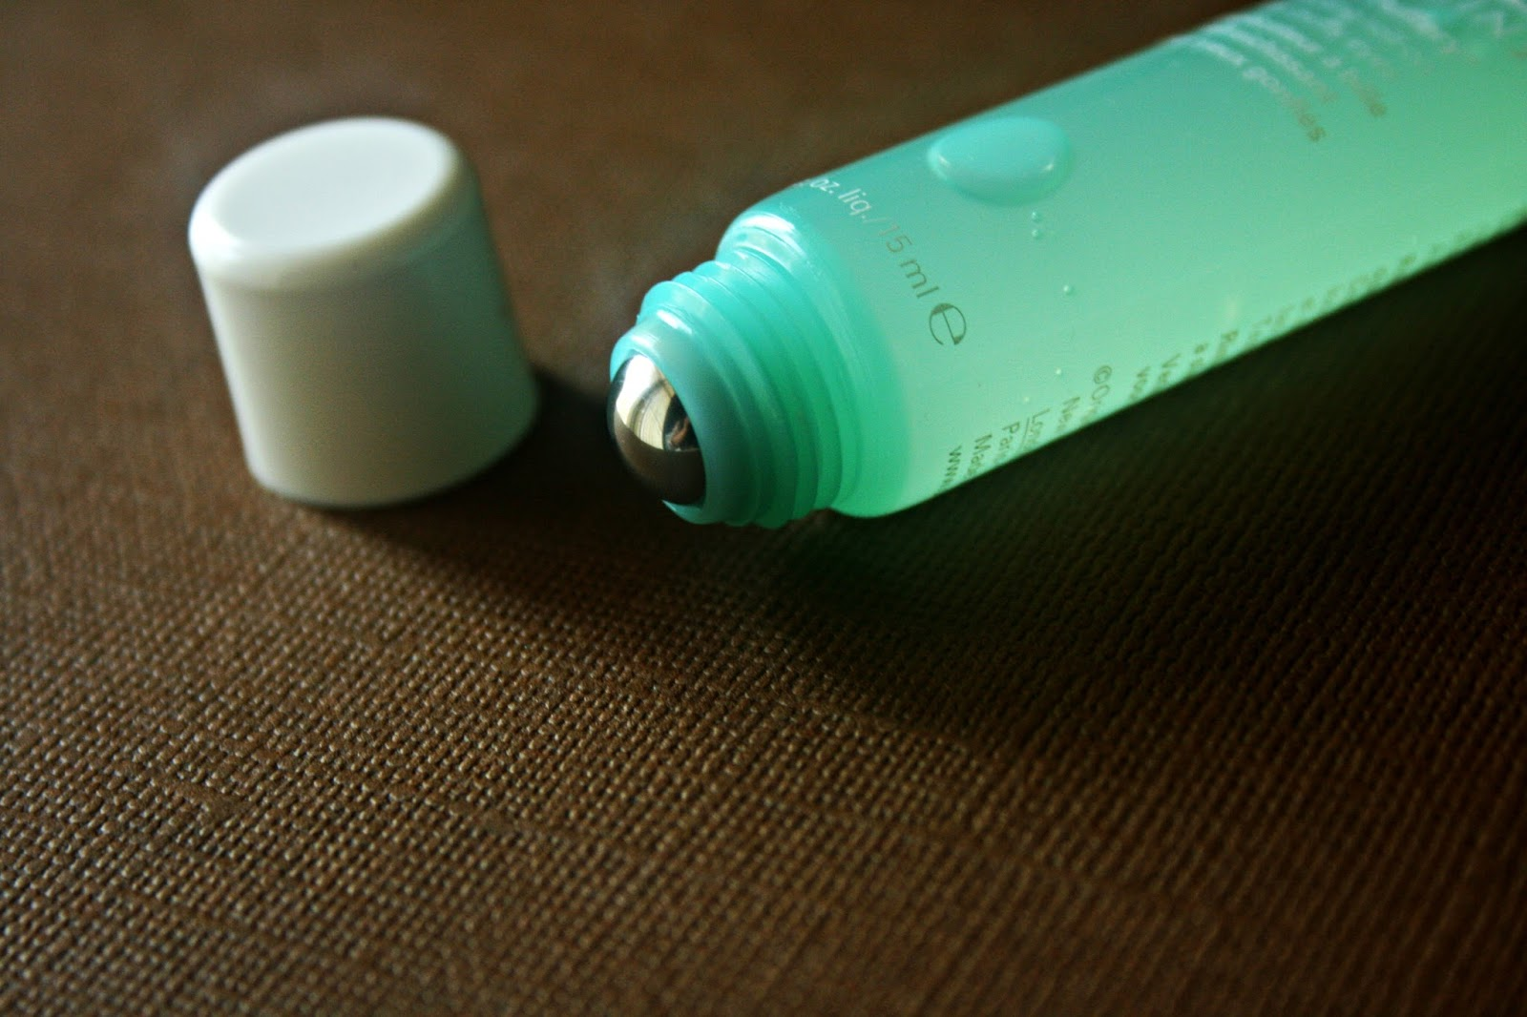
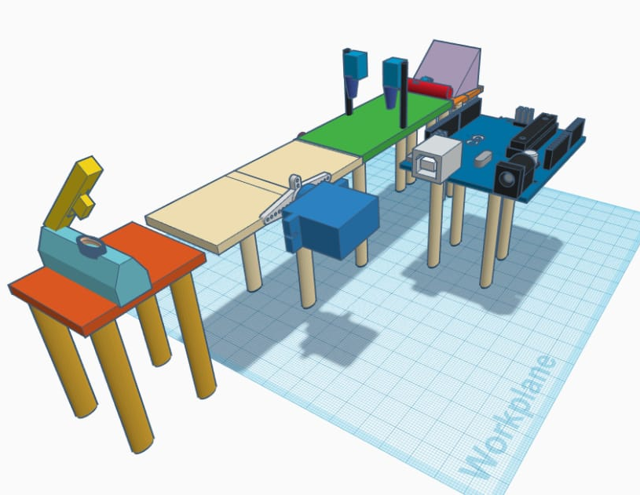
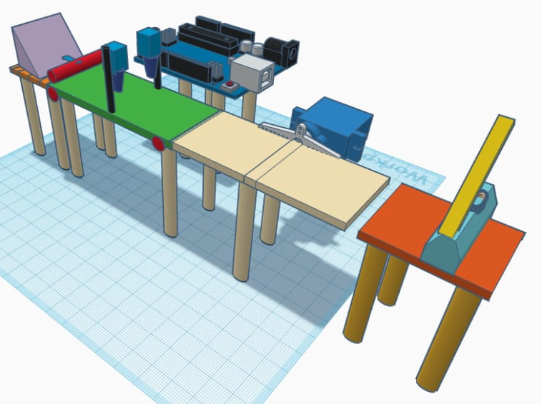
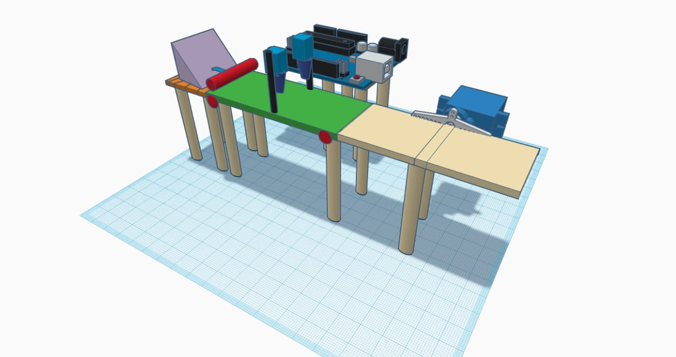
PROPOSED MODEL:
Glue filled in roll on container
Linear servo actuators
Tray for keeping paper
Feeding rollers
Servo motor
Punching machine
Conveyor belt
Motor for rotating the conveyor belt
Arduino and motor shield

Slide 14
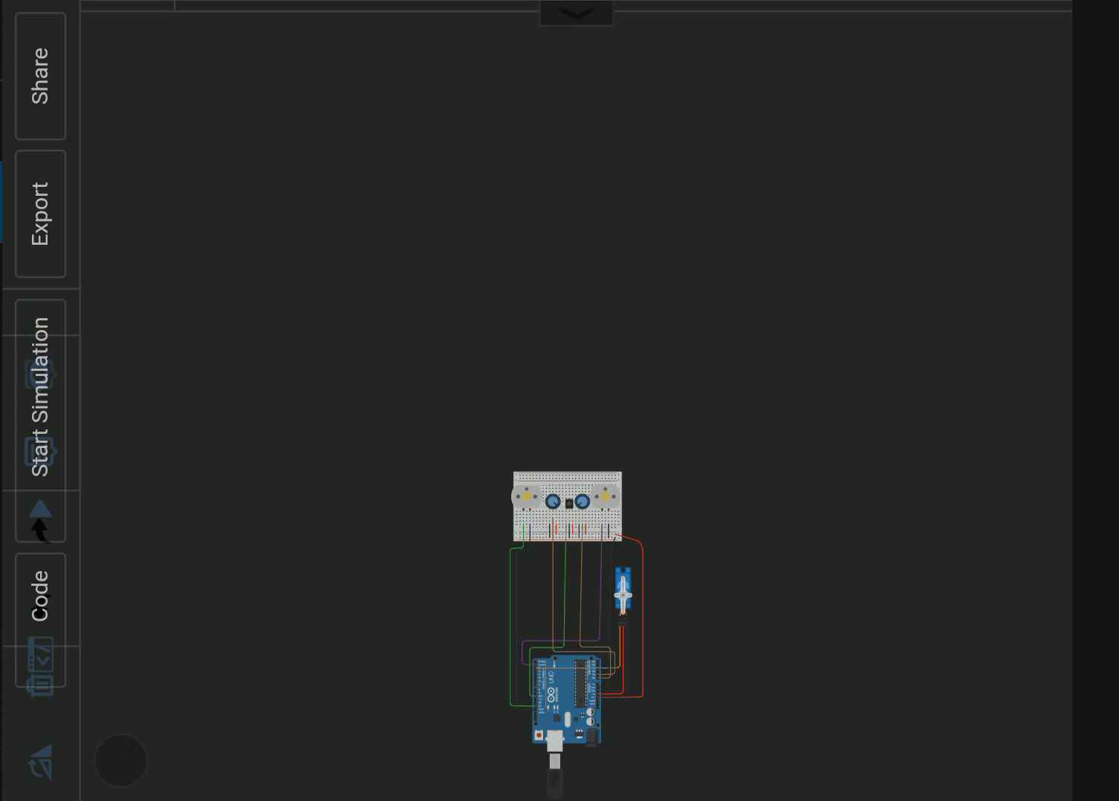
Simulation model in tinkercad
LINK:https://www.tinkercad.com/things/9jxihJYIf2H-ee-lab/editel?sharecode=o70dY4kcI54FgaDSGNl-vqSNsg8Belpk17SCcnSQsf8

Slide 15
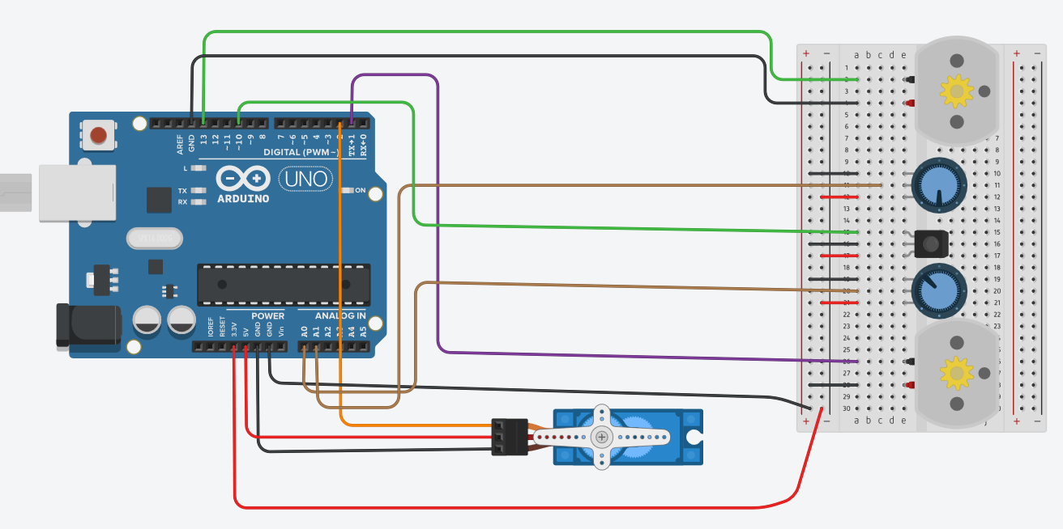
TINKERCAD CIRCUIT:
Motor for roller
Potentiometer as a substitute for servo actuator
IR Sensor
Motor for conveyor
Servo motor
Link:https://www.tinkercad.com/things/9jxihJYIf2H-ee-lab/editel?sharecode=o70dY4kcI54FgaDSGNl-vqSNsg8Belpk17SCcnSQsf8

Slide 16
WORKING:
The tray holds the raw material (A3 paper 1-2mm thickness).
Then the papers are pulled one at a time onto the belt(rotating) with the help of rollers.
ROLLERS->are made from PVC pipes covered with some duct tape to provide grip to pull the papers.
2 rollers each rotating in the opposite directions pull the paper.
[the rollers are approx. 1-2mm apart from each other]
The rollers are connected to separate motors. [DC Motor]
The belt moves in such a way that the paper is brought to the glue pulley, thereby applying glue on the edges of the paper.

Slide 17
The glued paper then falls on the folding station.
the servo motor connected with the Arduino performs the task of folding the paper .
THE FOLDING STATION:
The folding station requires a motor connected to the Arduino which gets it to run for 15s and relax for 2s.
During the relaxation time the paper bag needs to be manually cut/punched for handles.

Slide 18
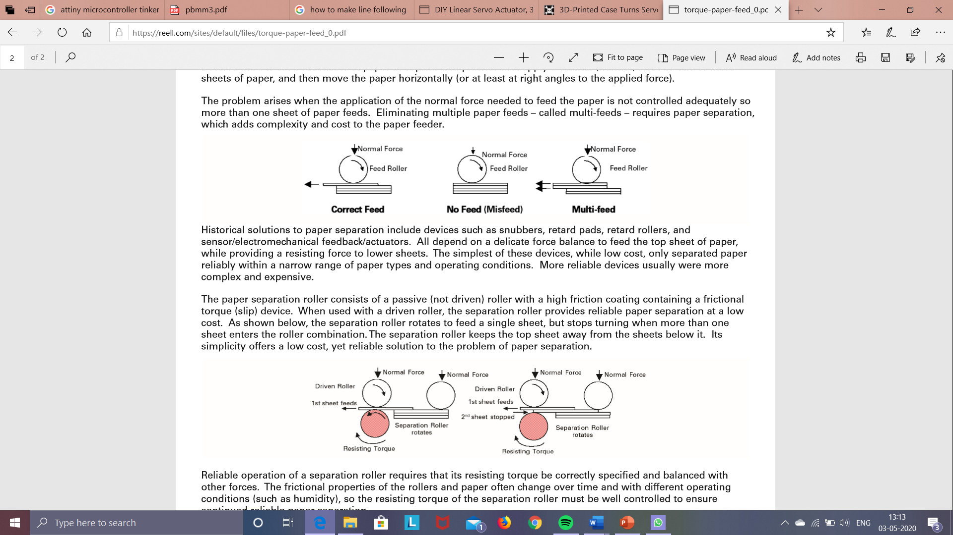
The Problem: (FEEDING THE PAPER)
Multiple sheets of paper feed into a printer or copier because the feed mechanism fails to separate the paper.
The problem arises when the application of the normal force needed to feed the paper is not controlled adequately so more than one sheet of paper feeds. Eliminating multiple paper feeds – called multi-feeds – requires paper separation, which adds complexity and cost to the paper feeder.

Slide 19
The solution: (FEEDING THE PAPER)
Reliable operation of a separation roller requires that its resisting torque be correctly specified and balanced with other forces.
The frictional properties of the rollers and paper often change over time and with different operating conditions (such as humidity), so the resisting torque of the separation roller must be well controlled to ensure continued reliable paper separation.
Friction between the rollers approximately estimated to be 0.4µ

Slide 20
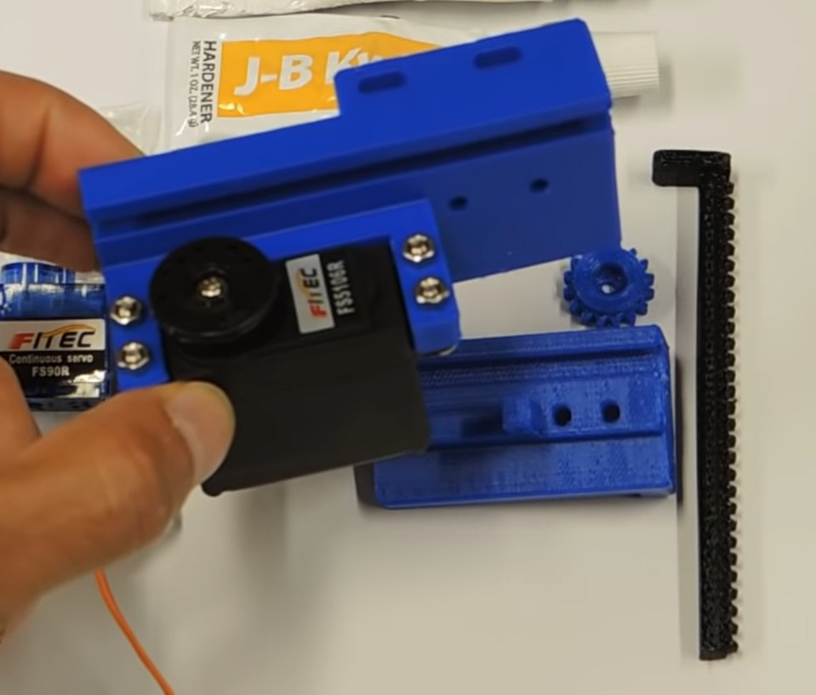
THE GLUING STATION:
The Fevigum bottle is fixed by means of L-clamp, on the linear motor actuator.
The requirement is to get 2 opposite, parallel edges of newspaper glued.
This is achieved by the linear servo actuator which is connected to the Arduino.
Upon setting up the program, the pusher with the glue container glides along the flaps/ edges of the paper and hence the glued paper passes on to the folding station where it gets folded
actuator

Slide 21
Advantages and Disadvantages of model
ADVANTAGES
The paper pouch of sufficient size and strength can be manufactured.
It helps to reduce or eliminate the use of plastic bags.
It occupies less space and consumes less electricity.
The machine is easy to operate as all the function is automatic once paper is feeded.
DISADVANTAGES
The complete model is not automated.
It requires human interference to ensure that the work is taking place properly.
It is slightly fragile as the components are made from recycled materials.
All the finished products may not be of the same size.

Slide 22
List of Conclusions :
The machine is capable of producing paper pouch efficiently and within less time than conventional use.
The paper pouch manufactured by machine is having enough strength for the use of keeping small items.
This is because of the 5V DC geared motor used in entire system.
Also glue needs to be replaced frequently.
Further one human assistance is required.

Slide 23
References:
[1].Geared DC motors (webpage) - https://www. engineers garage. com/insight/how- geared-dc-motor-works
[2]. L293D datasheet - http://www. ti.com/lit/ds /symlink /l293.pdf
[3]. Programmer‟s Notepad (webpage) - https:// en.wikipedi a.org/wiki/Programmer%27s_Notepad
[4]. WINAVR (webpage) - http://www.webring.or g/l/rd?ring= avr;id=59;url=http%3A%2F%2Fwinavr%2Esourceforge%2En et%2F
[5]. Arduino IDE (webpage) - https:// www. arduino .cc/e n/guide/environment

Slide 24
THE END

